Slide 1



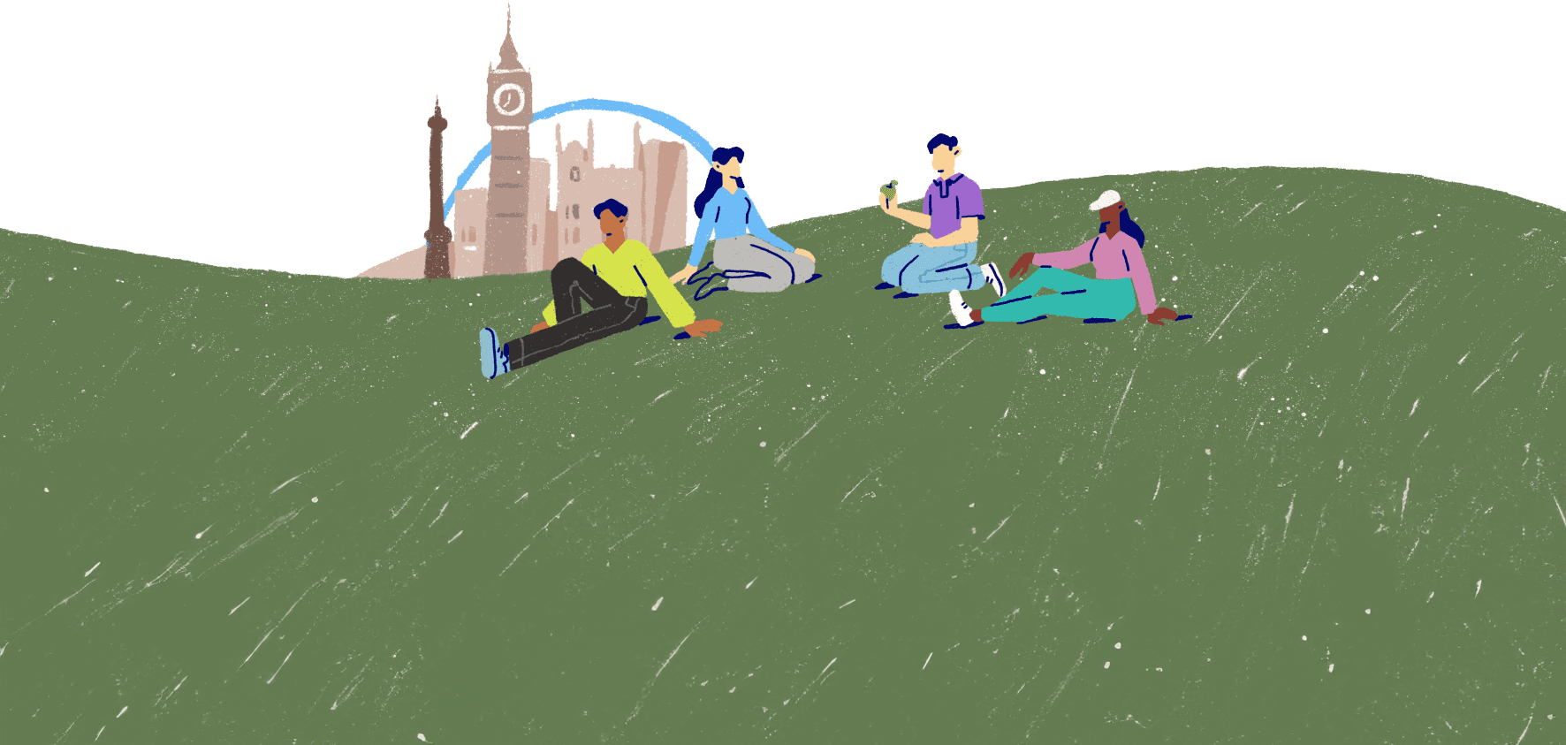
Recognising when our mental wellbeing is suffering
Lesson 9

Slide 2



Knowledge and awareness
Knowing all about mental health and ill health enables us to identify difficulties that we or others may be experiencing.
It's important to be able to recognise when something may be having a negative effect on our own or another person's mental wellbeing.
It's useful to be able to identify the triggers but also to spot the symptoms.
What signs could there be that a person is struggling with their mental health or wellbeing?

Slide 3
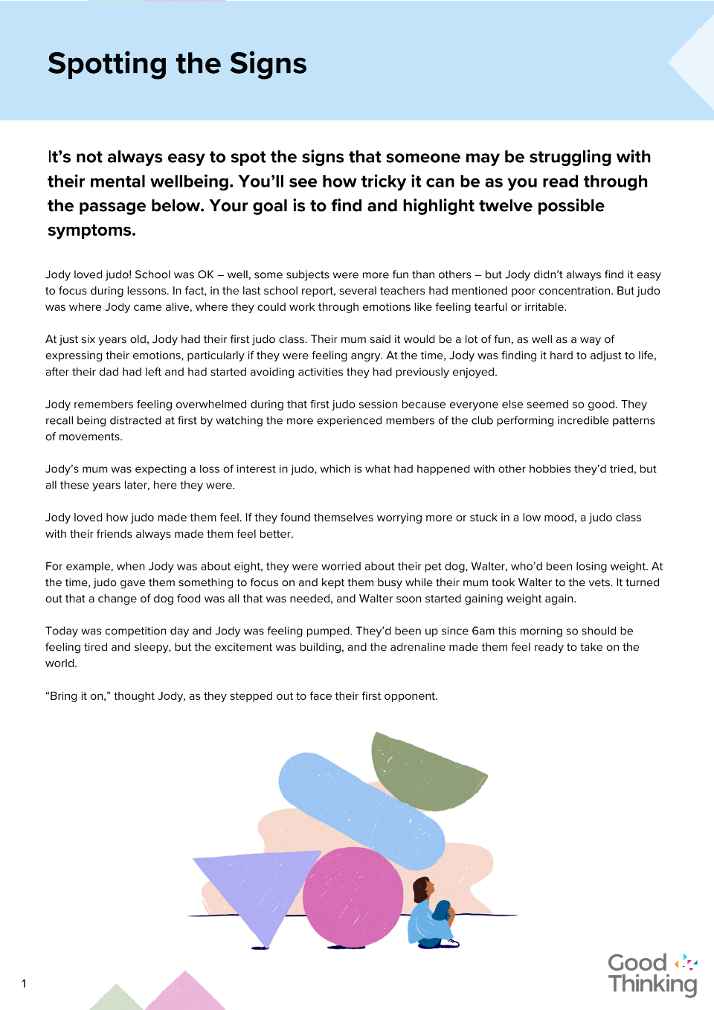
Spotting the signs
Mental health challenges and poor mental wellbeing can be more difficult to recognise than physical health or wellbeing issues.
Read through the short piece of fiction and highlight words or phrases in the text that you think could be signs that a person might be struggling with their mental health or wellbeing.

Slide 4



Are you OK?
Photo from Canva
It's not always possible to spot the signs so it's really important to check in with your friends and to create a safe space for them to open up.
Let's take a look at some top tips for starting a conversation with a friend to see how they're feeling.

Slide 5
Starting the conversation
Timing is everything
Think about whether now is the best time to have this chat.
Find a quiet place
Have a chat in private, away from distractions.
Hey, do you have time for a catch-up?
Shall we find somewhere quiet to chat?
How to begin your chat
Simply ask how they've been.
Check in with them
Let them know you've seen a change in their behaviour and that you care.
How have you been doing?
I've noticed that you haven't seemed yourself lately. Is there anything you want to talk about?

Slide 6

Keep the conversation going
Show your friend you are actively listening and ask them more about things that have happened and how that's made them feel.
Show your friend that you appreciate them sharing their feelings with you and let them know they are brave to do so.
Listen but don’t try to fix things for your friend. It's unlikely you'll have answers or solutions but let them know you're here if they need to chat.
Remind your friend that there are organisations and resources out there that they might find useful. See if they want your help to access more support.

Slide 7
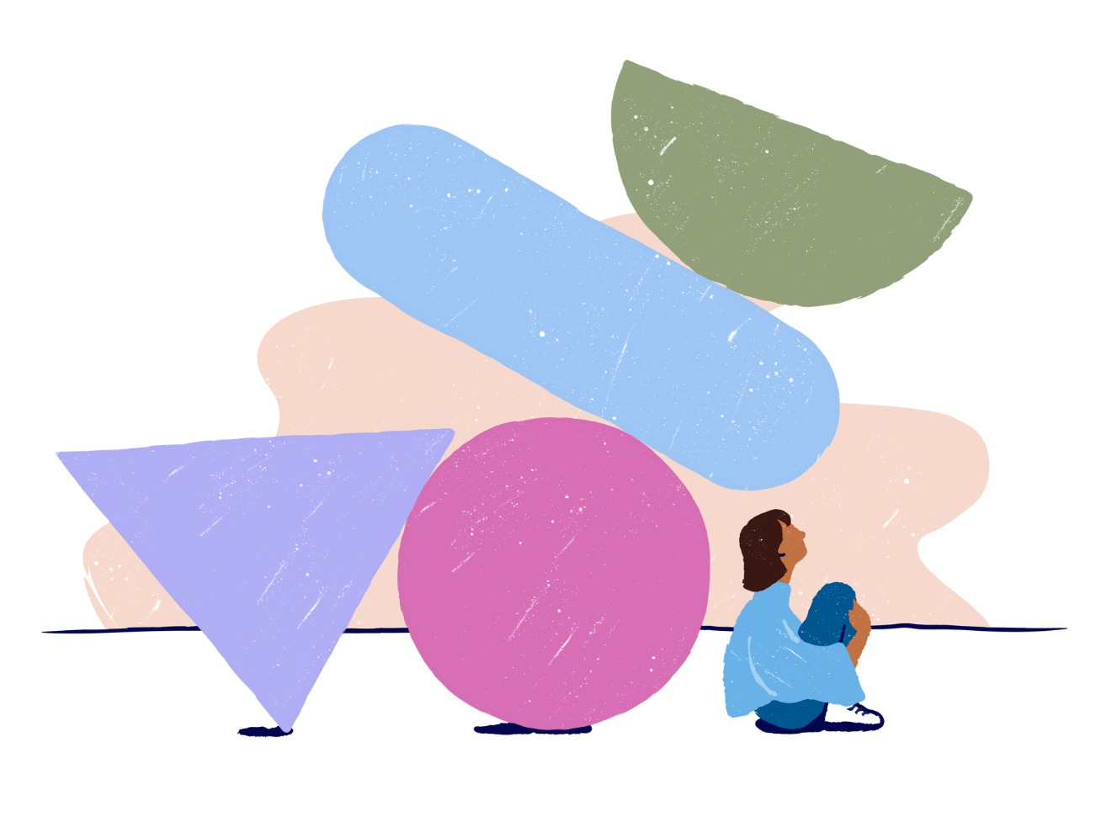
Am I OK?
​Let's practise a mindfulness
technique now to check in with ourselves.
Supporting someone else can be difficult. And checking in with ourselves is sometimes even harder than checking in with someone else.
If we're going through a difficult time, we might distract ourselves and focus on other people instead of stopping to focus on how we're feeling. But avoiding difficulties rarely makes them go away.

Slide 8


Body scan
Get comfortable and close your eyes if you wish to.
Relax your shoulders and focus on breathing slowly and deeply.
Concentrate on one body part at a time and notice any sensations you can feel.
These sensations might be temperature, pressure, discomfort, tingling, tightness, or other sensations.
Start at your feet , then gradually move up the body.
You might focus on one side of your body first, then the other.
Focus on each part and notice the sensations without trying to change them. They might be comfortable or pleasant sensations, or they might be unpleasant or even painful sensations.
Keep returning your focus back to your breathing and your body parts when your mind wanders.
When you reach your head, consider how you're feeling overall, and which emotions are the strongest for you at the moment.
Photo by Paul Earle on Unsplash

Slide 9

"No visible symptoms, no runny nose, just a head full of darkness. No fever or rash, no fractures or sprains, just a longing for something, unable to explain."
Hrihaan Usuf Wovera
Photo by Matt Hardy on Unsplash

Slide 10


